Slide 1

Nouvelle Vie
Angel Cosio Daniela Sanchez Ailyn Melendrez
Michael To Luis Cano Vazquez
Notes:
Luis

Slide 2
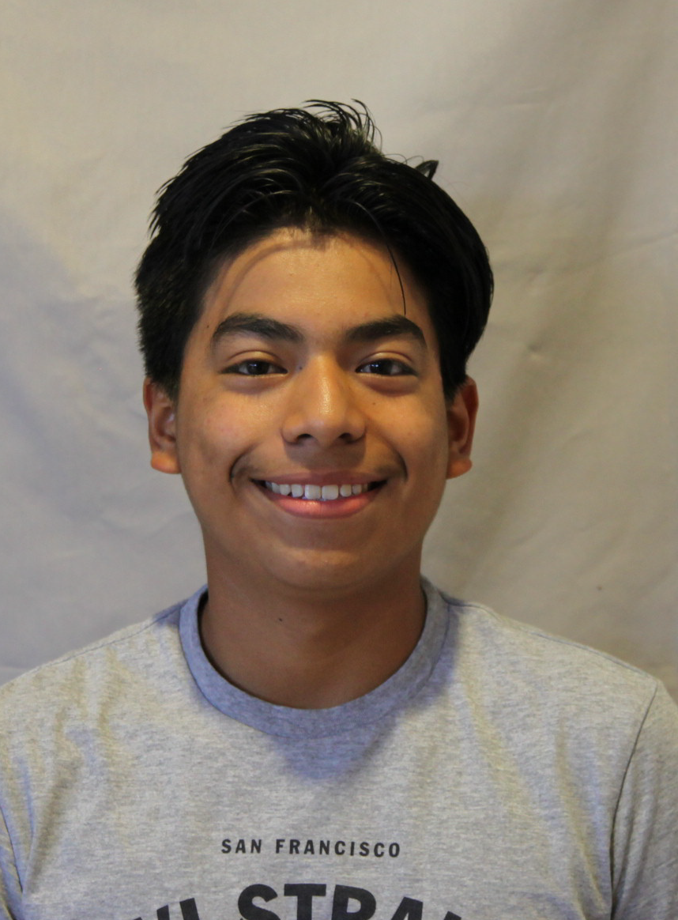

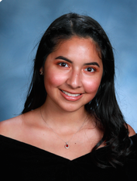
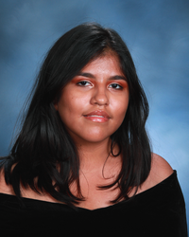
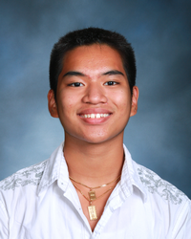
Team Members
ANGEL
DANIELA
LUIS
AILYN
MICHAEL
Notes:
Everyone

Slide 3
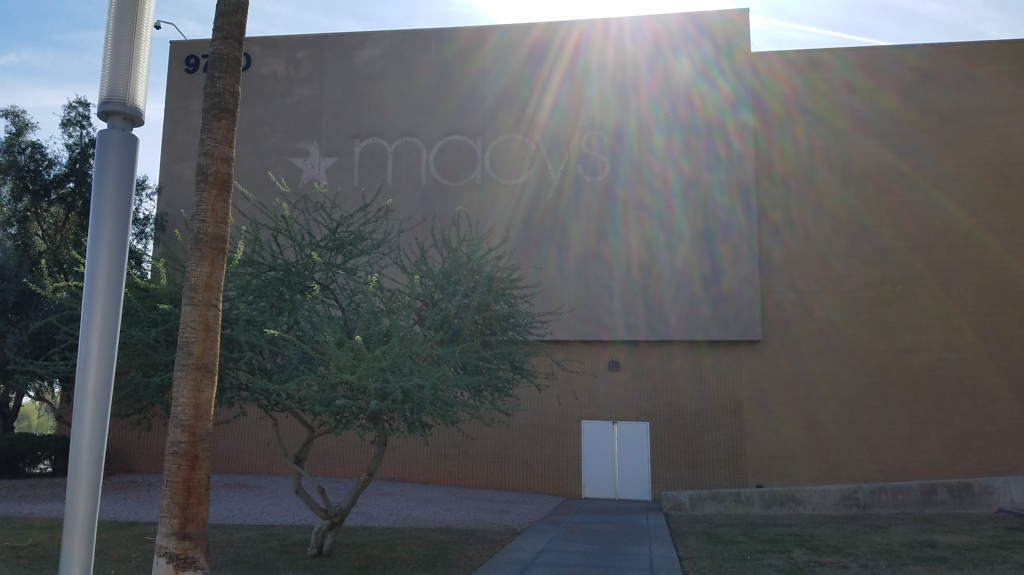
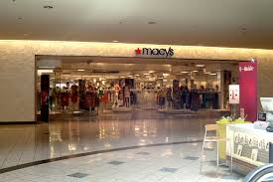
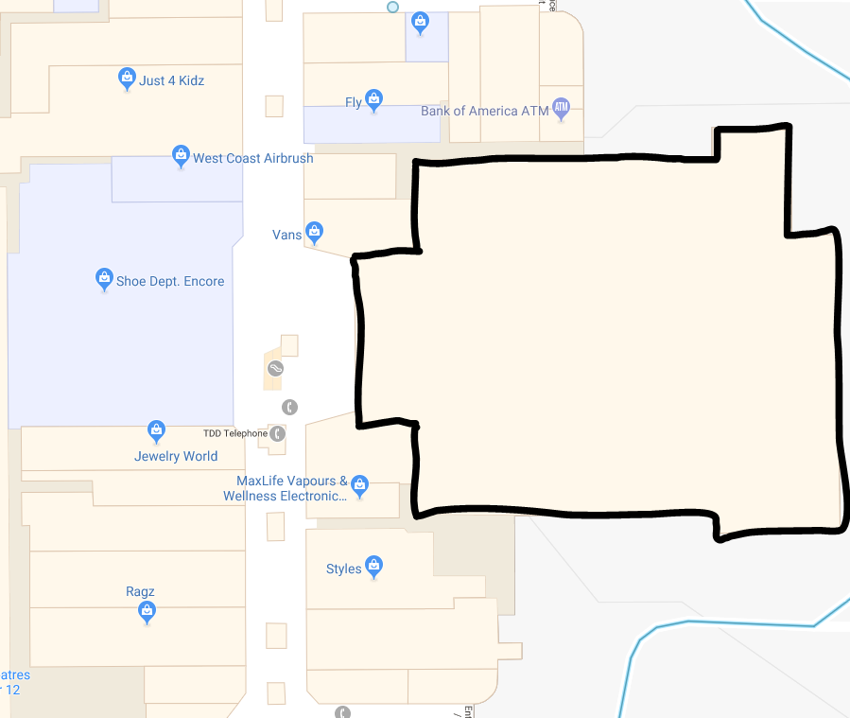
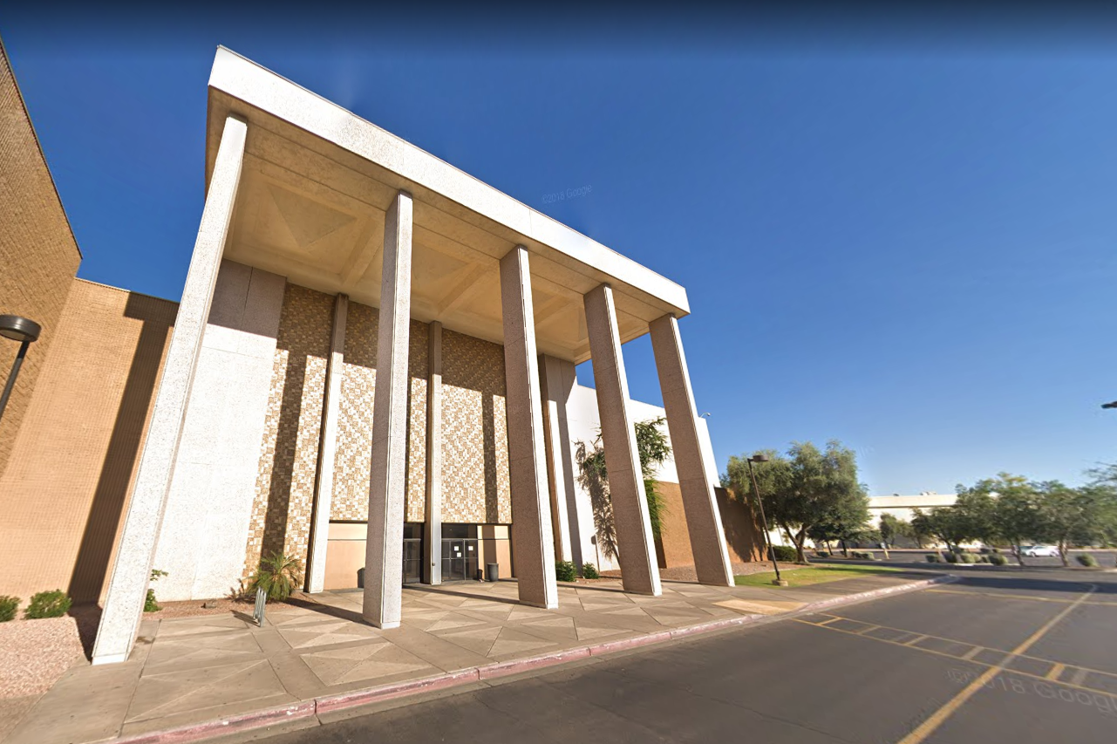
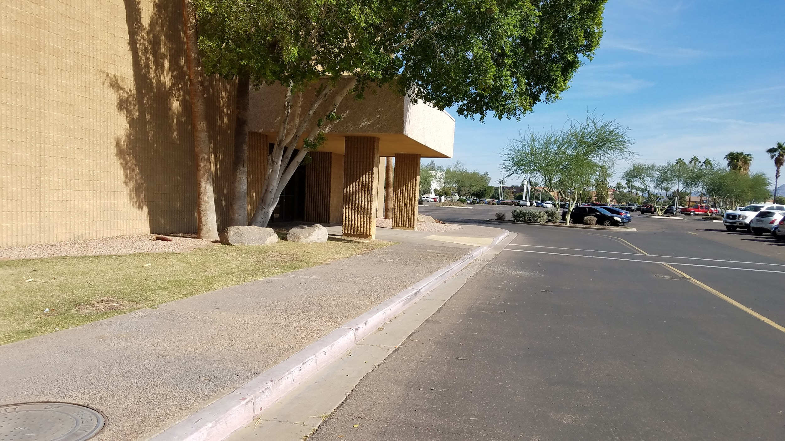
Site Location
North
Macys
West
East
South
Notes:
angel

Slide 4
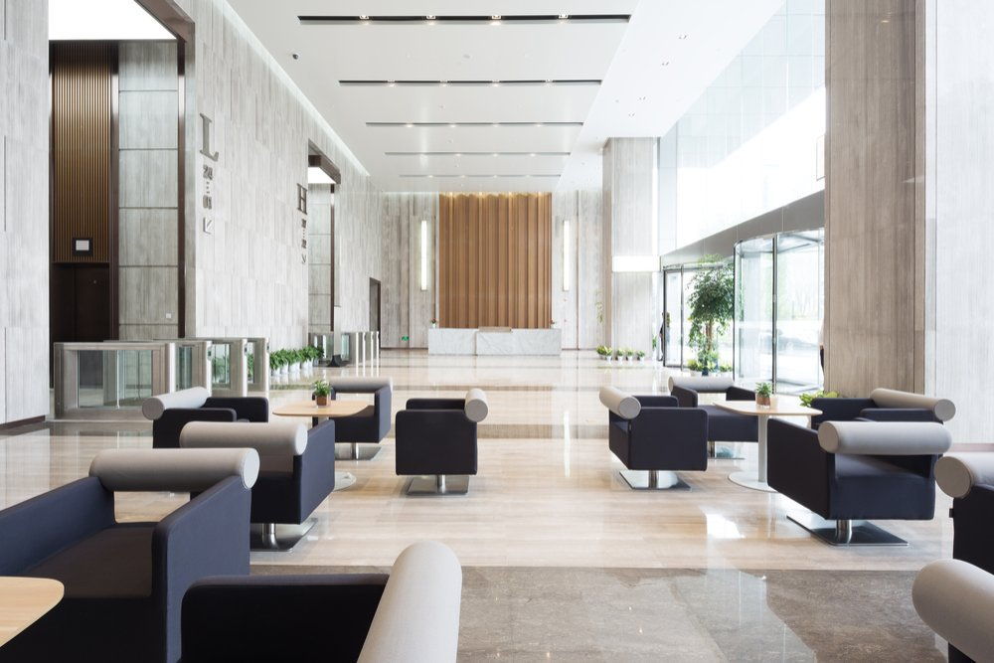
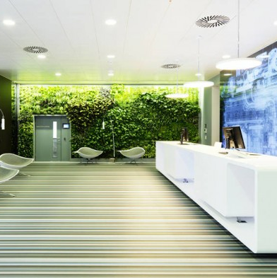
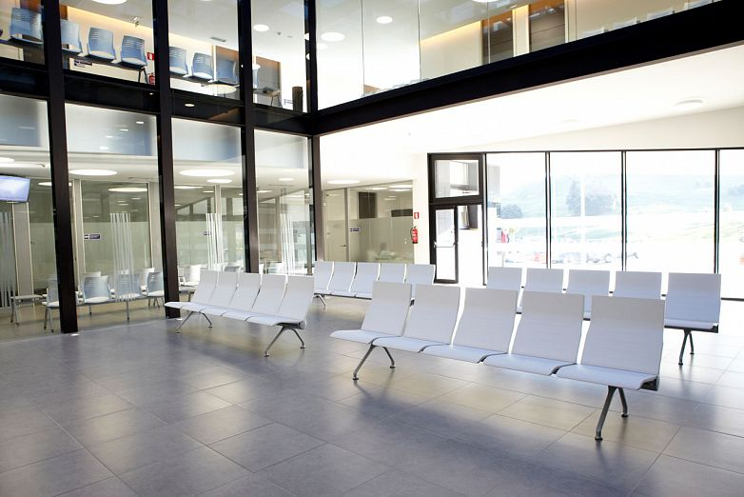
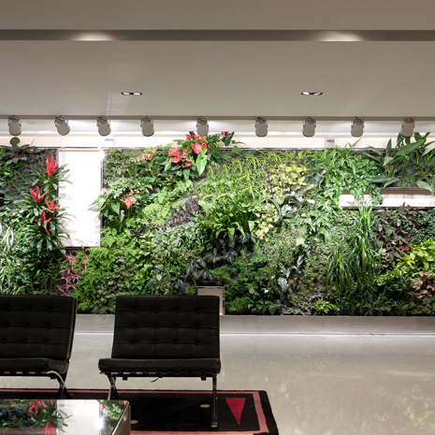
Guiding Principles
Copious amounts of natural light
Nature incorporated in our theme
Efficient lobby and waiting areas to ensure speedy service
Environmental awareness
Notes:
Angel

Slide 5
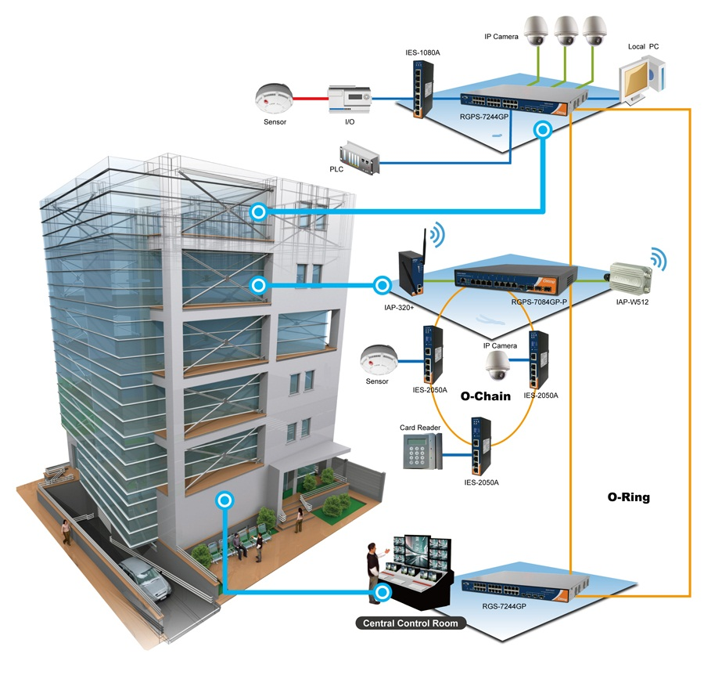
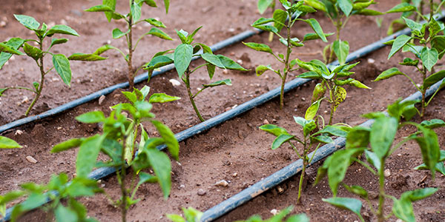
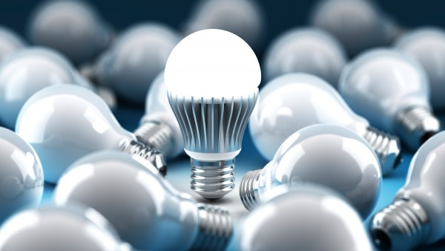
Sustainability
Water Efficiency: low-flow plumbing and native plants
Energy Efficiency: LED lights and HVAC systems)
Materials: local materials and products, and recycle conscious
Indoor Environment: Feature as much daylight in building, low emitting VOC materials
Notes:
ailyn

Slide 6
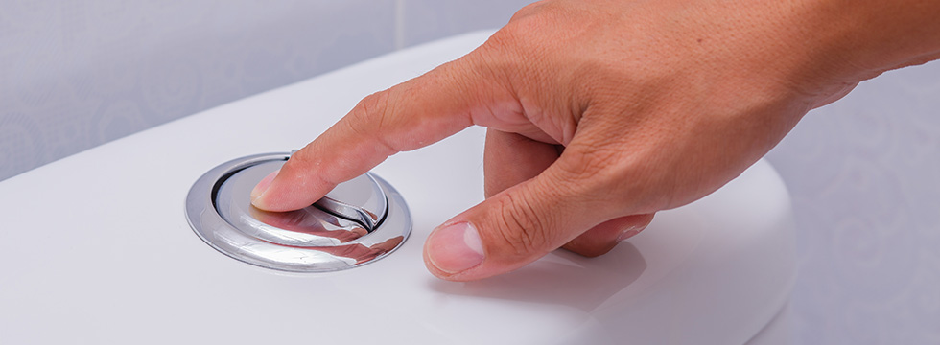
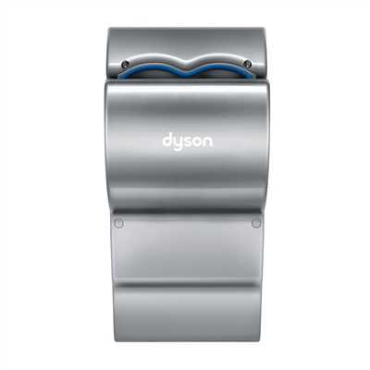
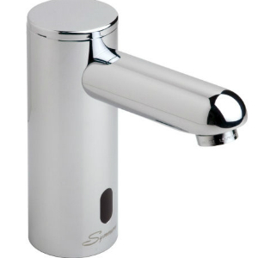
Restroom Sustainability
Toilets: Low Flow Toilets Save up to 60%
Faucets: Watersense Faucets Save up to 700 Gallons per faucet per Year
Air Dry: Airblade Hand Dryers Conserves 69% of energy Completely replaces paper towels
Notes:
ailyn

Slide 7
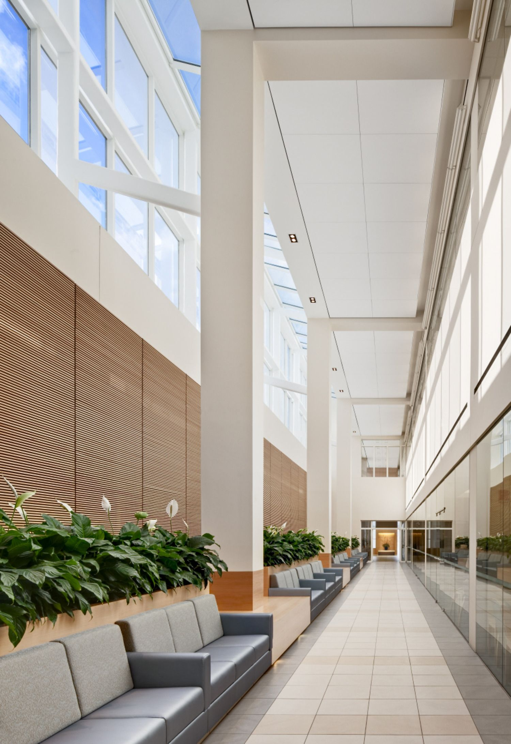
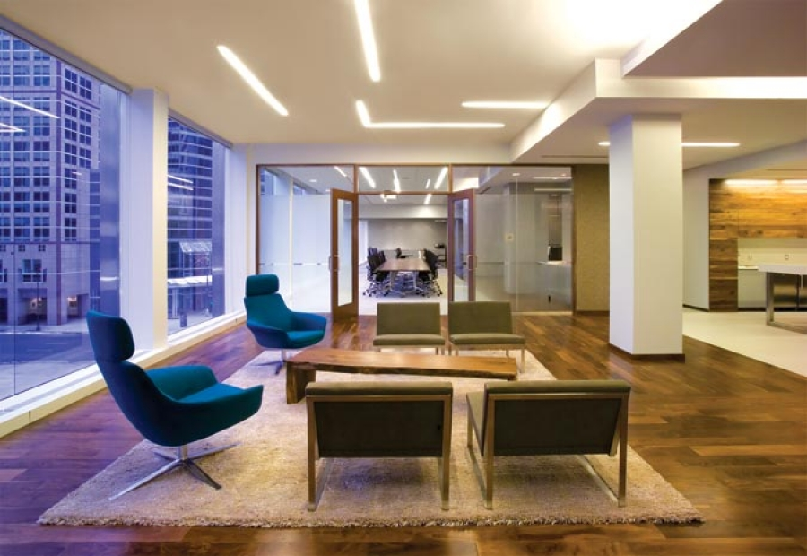
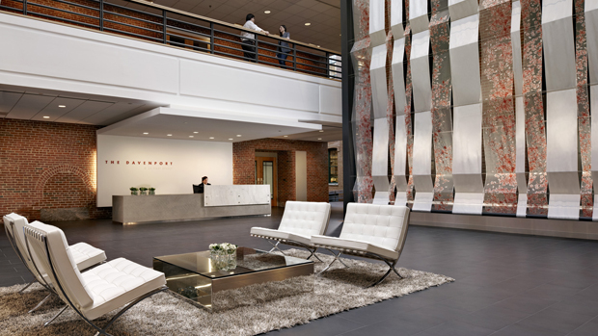
Inspiration (Interior)
Modern
Clean and pristine
Spacious seating areas
Attention drawing and direct lobby
Comforting environment
Notes:
Daniela

Slide 8
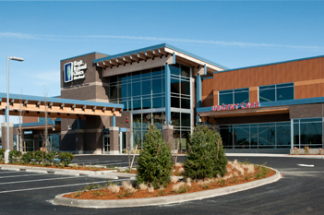
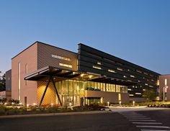
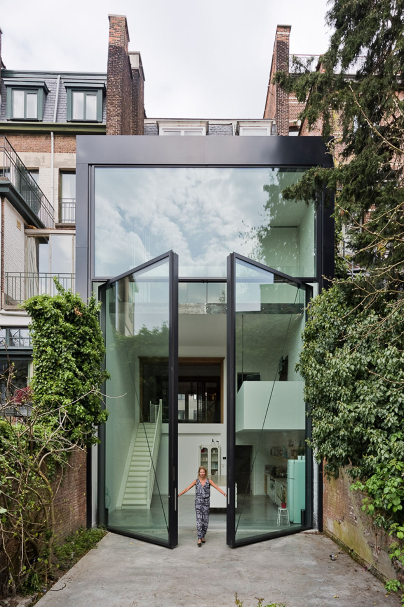
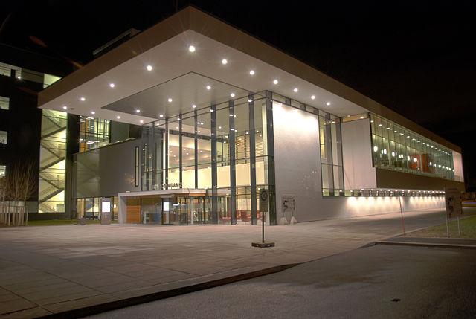
Inspiration (Exterior)
Futuristic
Glass Doors
Glass walls
Geometrical
Notes:
daniela

Slide 9
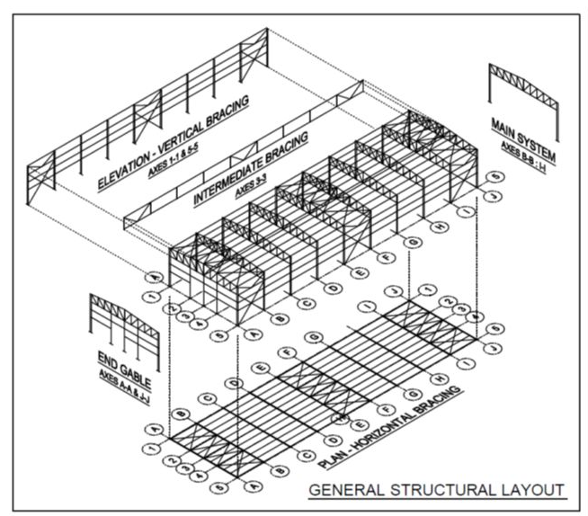
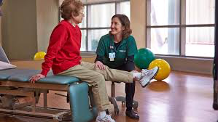
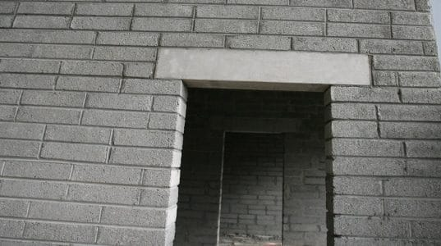
Structural Layout
Existing building (same foundation)
Structural lintel beam with windows
A new wall separating physical therapy section
Notes:
Michael

Slide 10
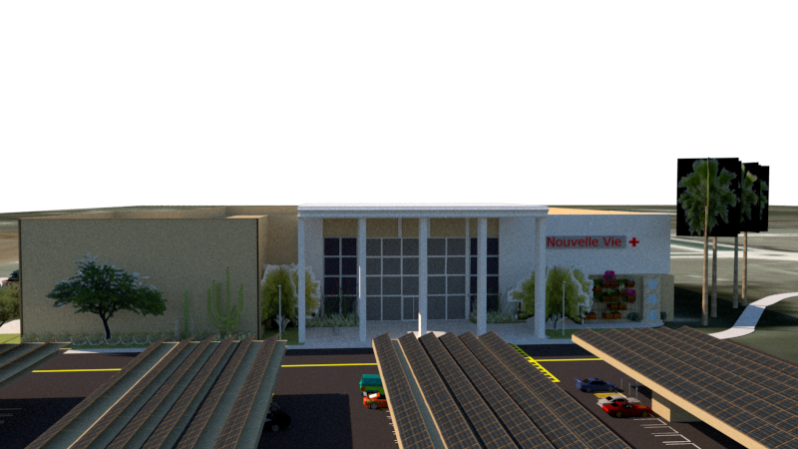
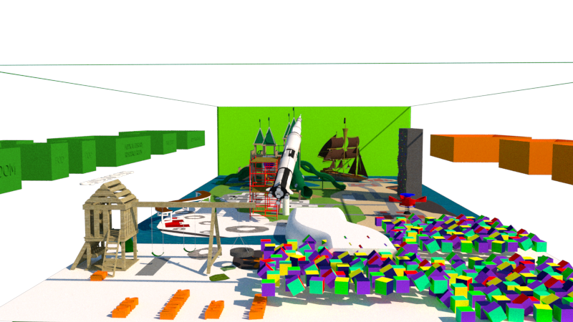
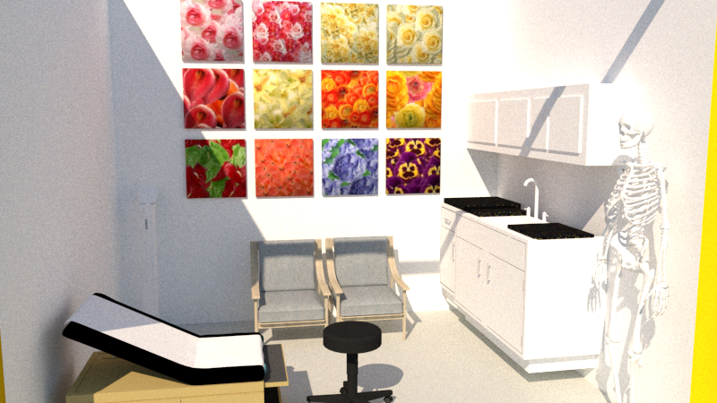
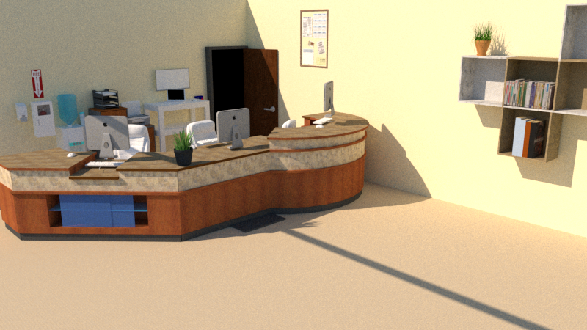
SketchUp Model
Notes:
Micheal

Slide 11


Slide 12
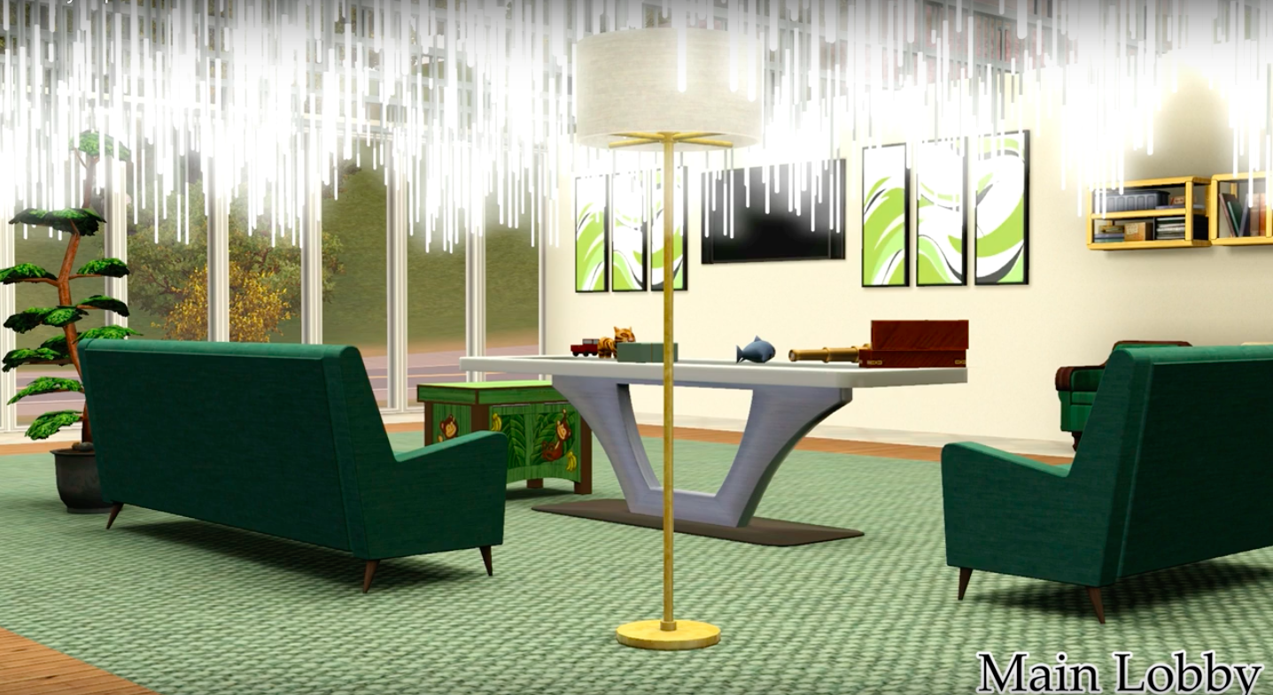

Slide 13
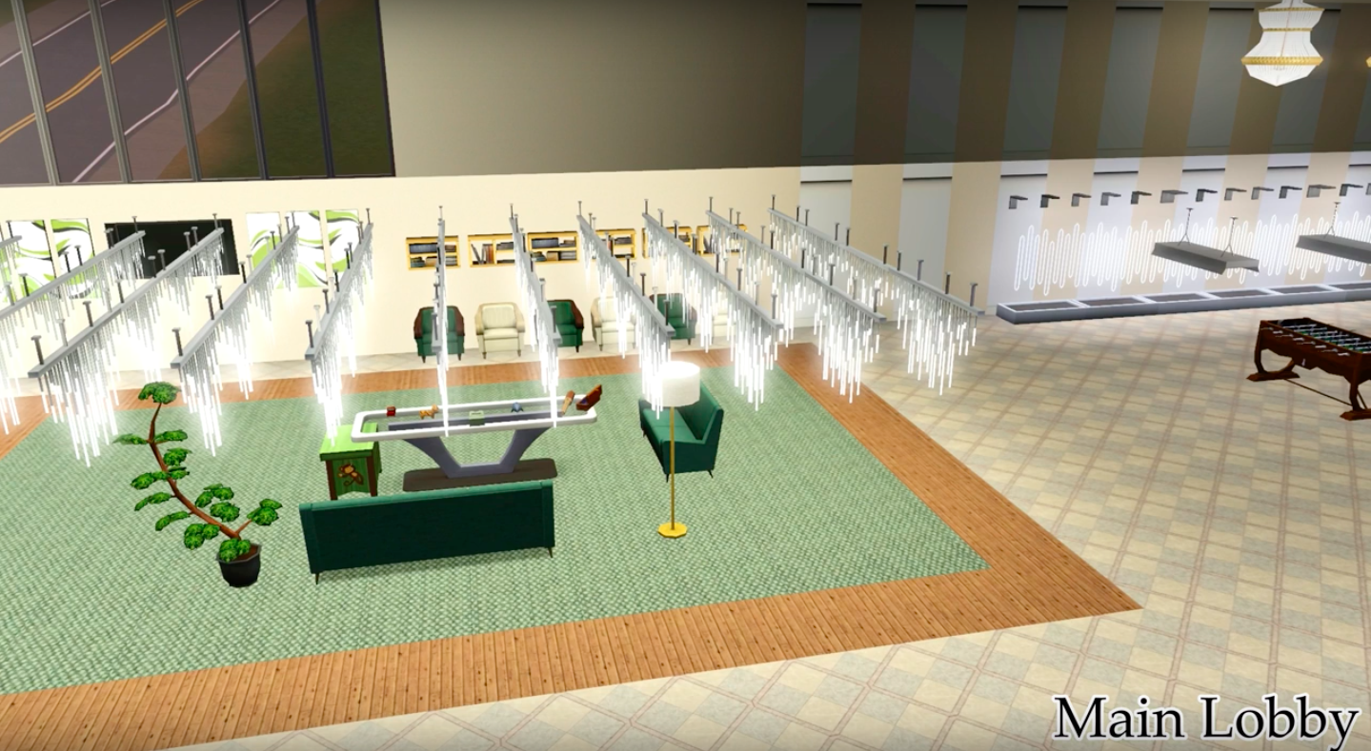

Slide 14
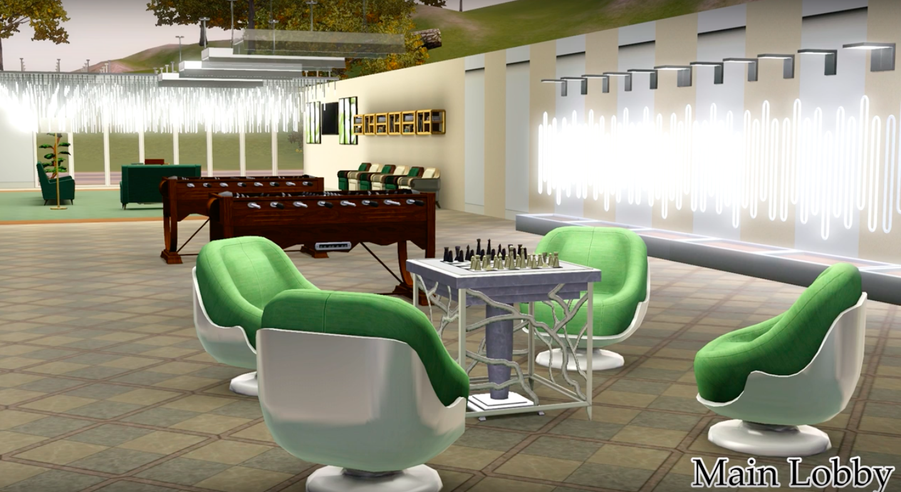

Slide 15
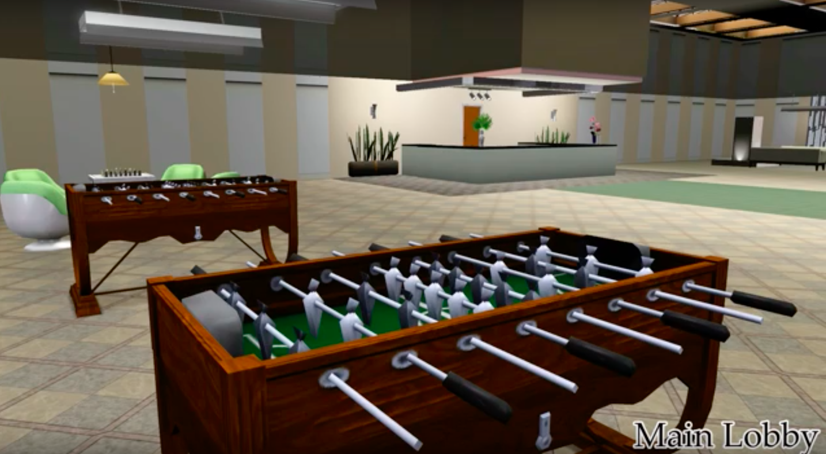

Slide 16
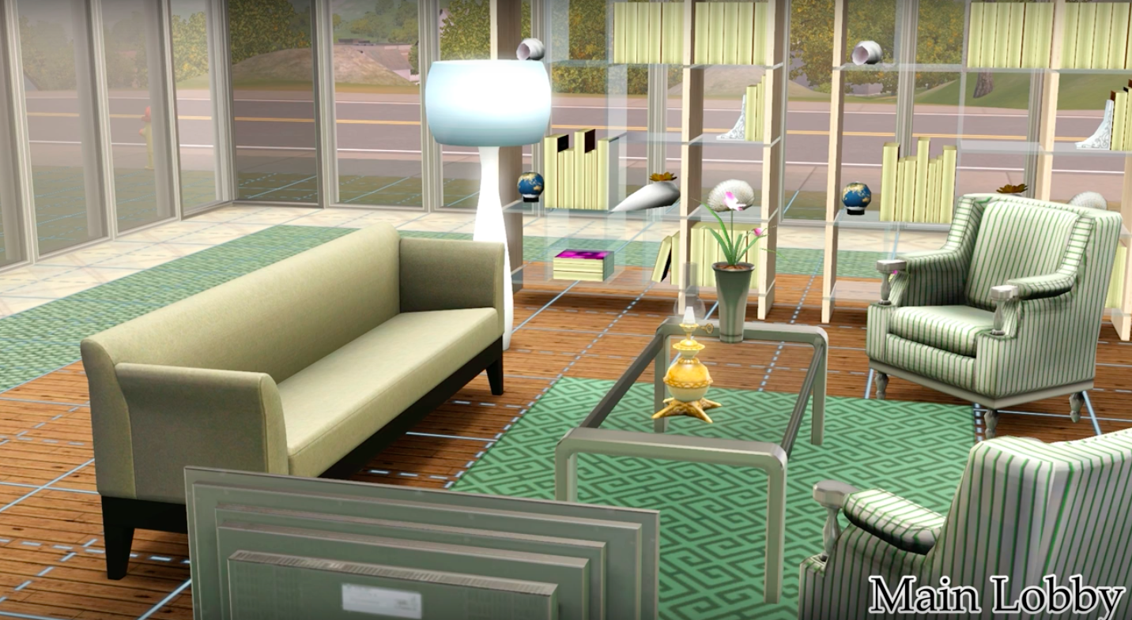

Slide 17
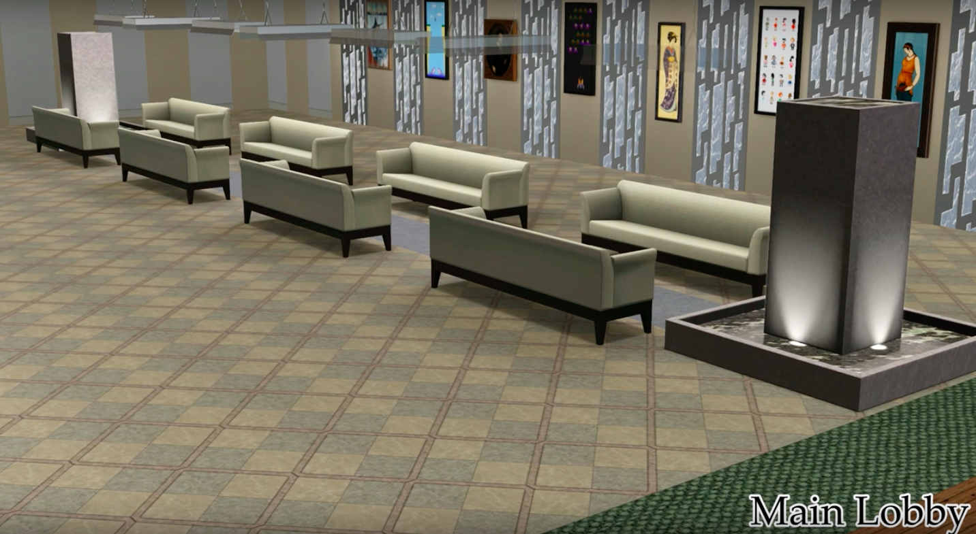

Slide 18
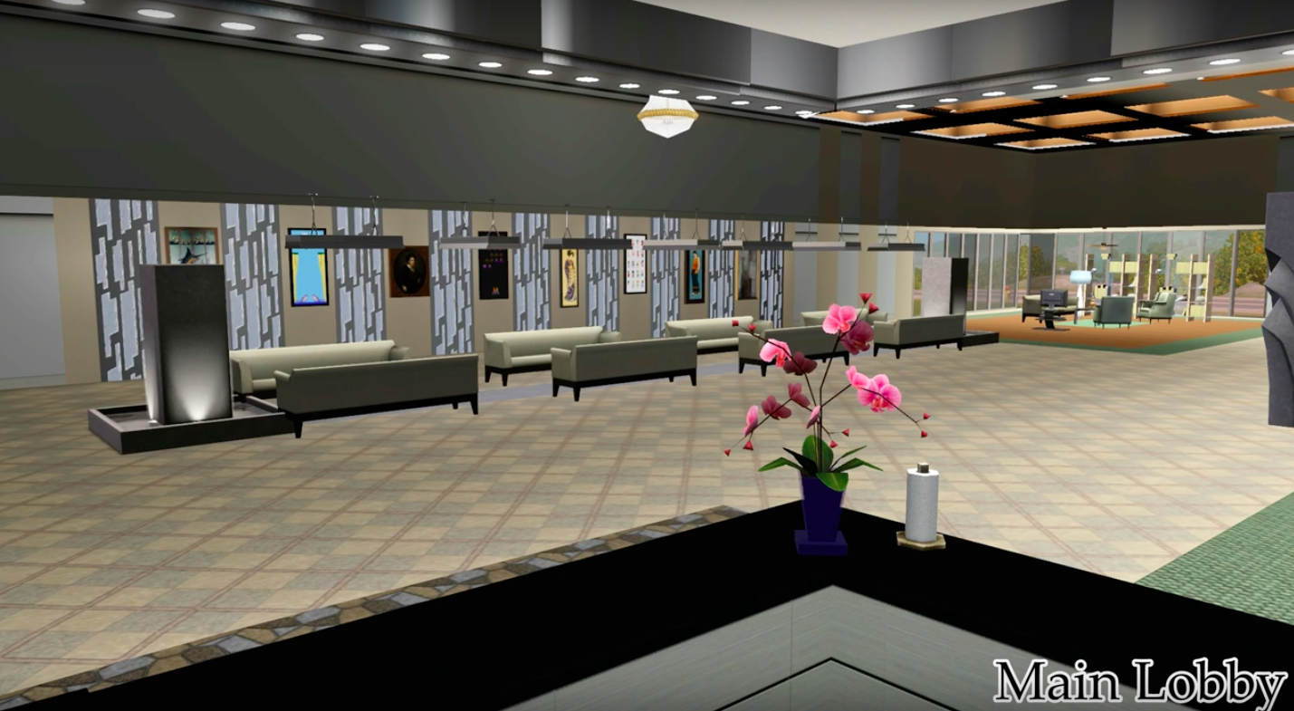

Slide 19
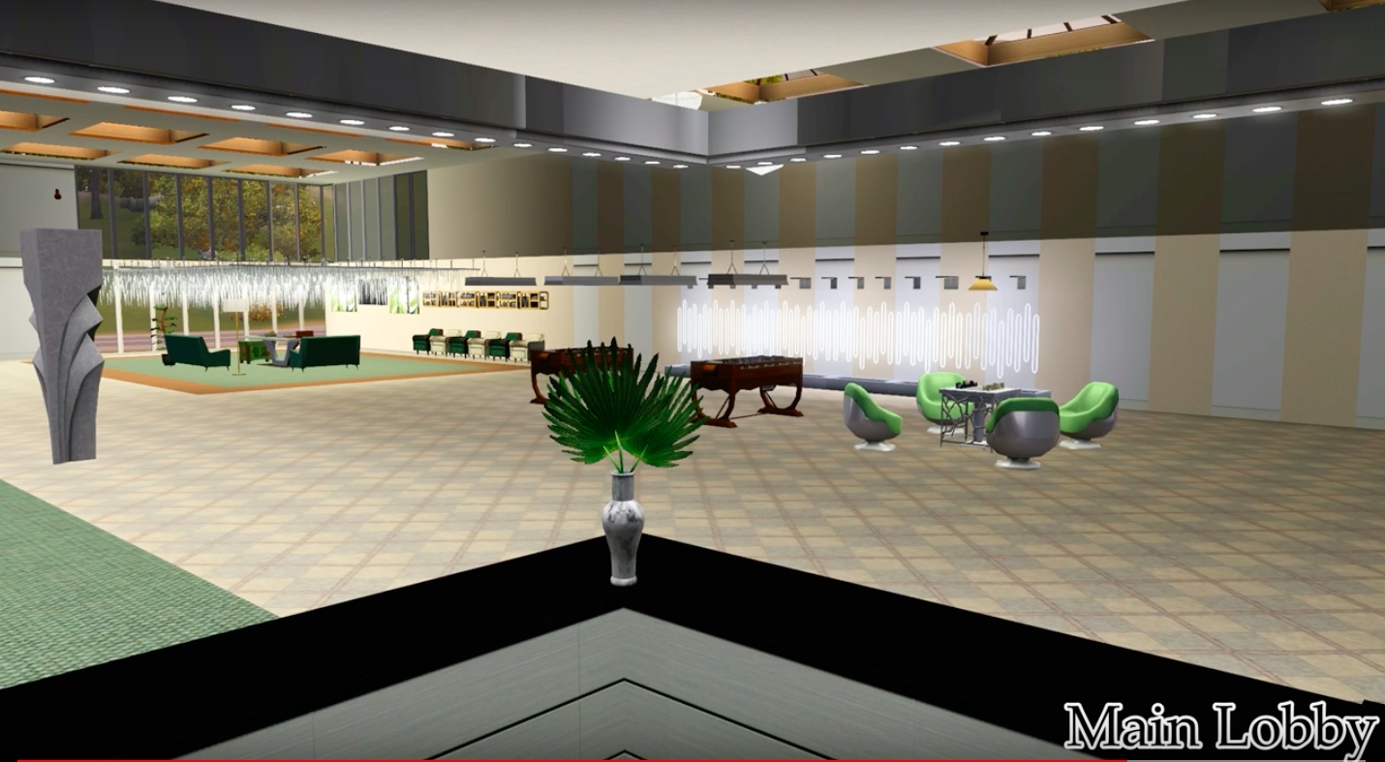

Slide 20
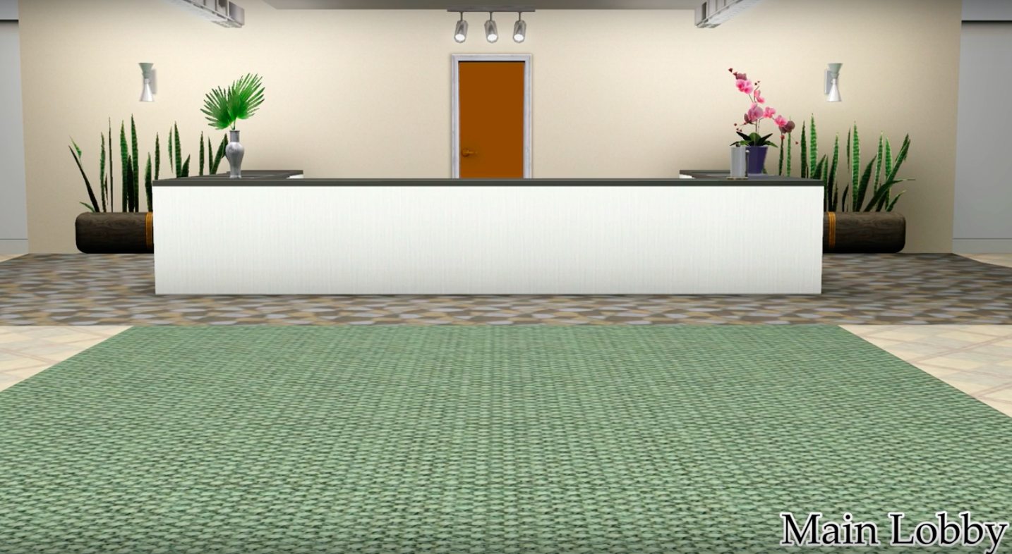

Slide 21
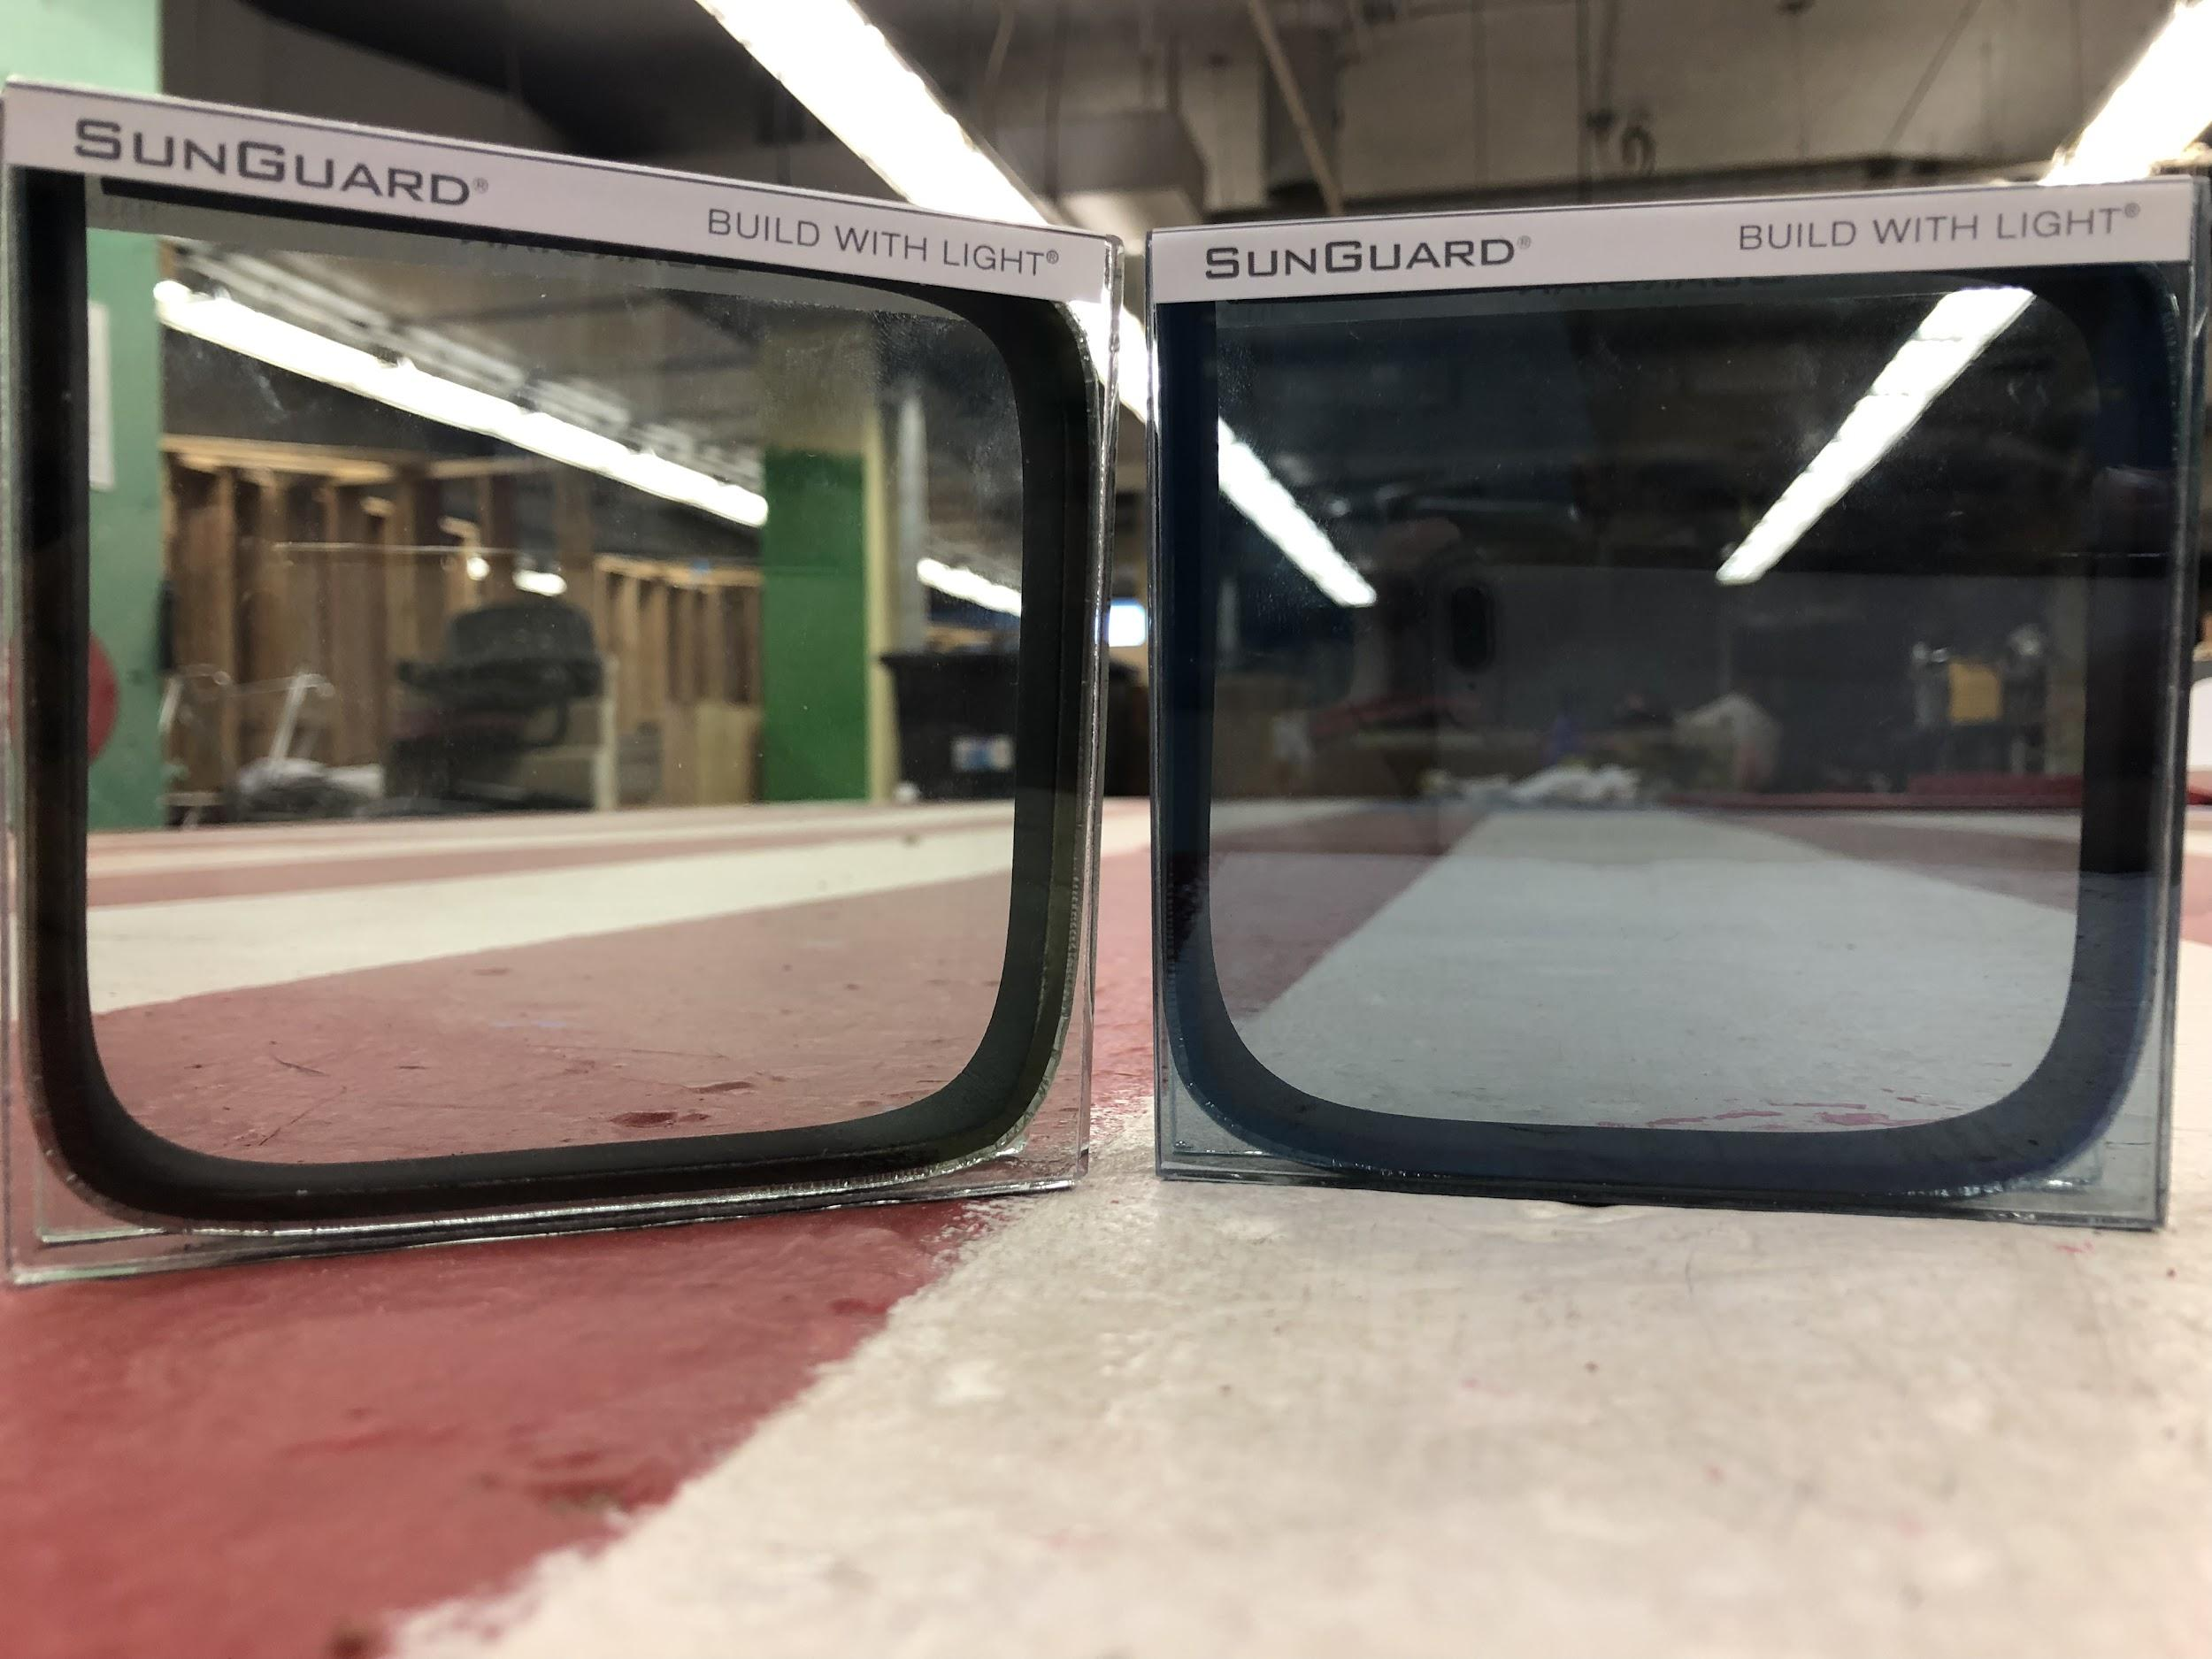
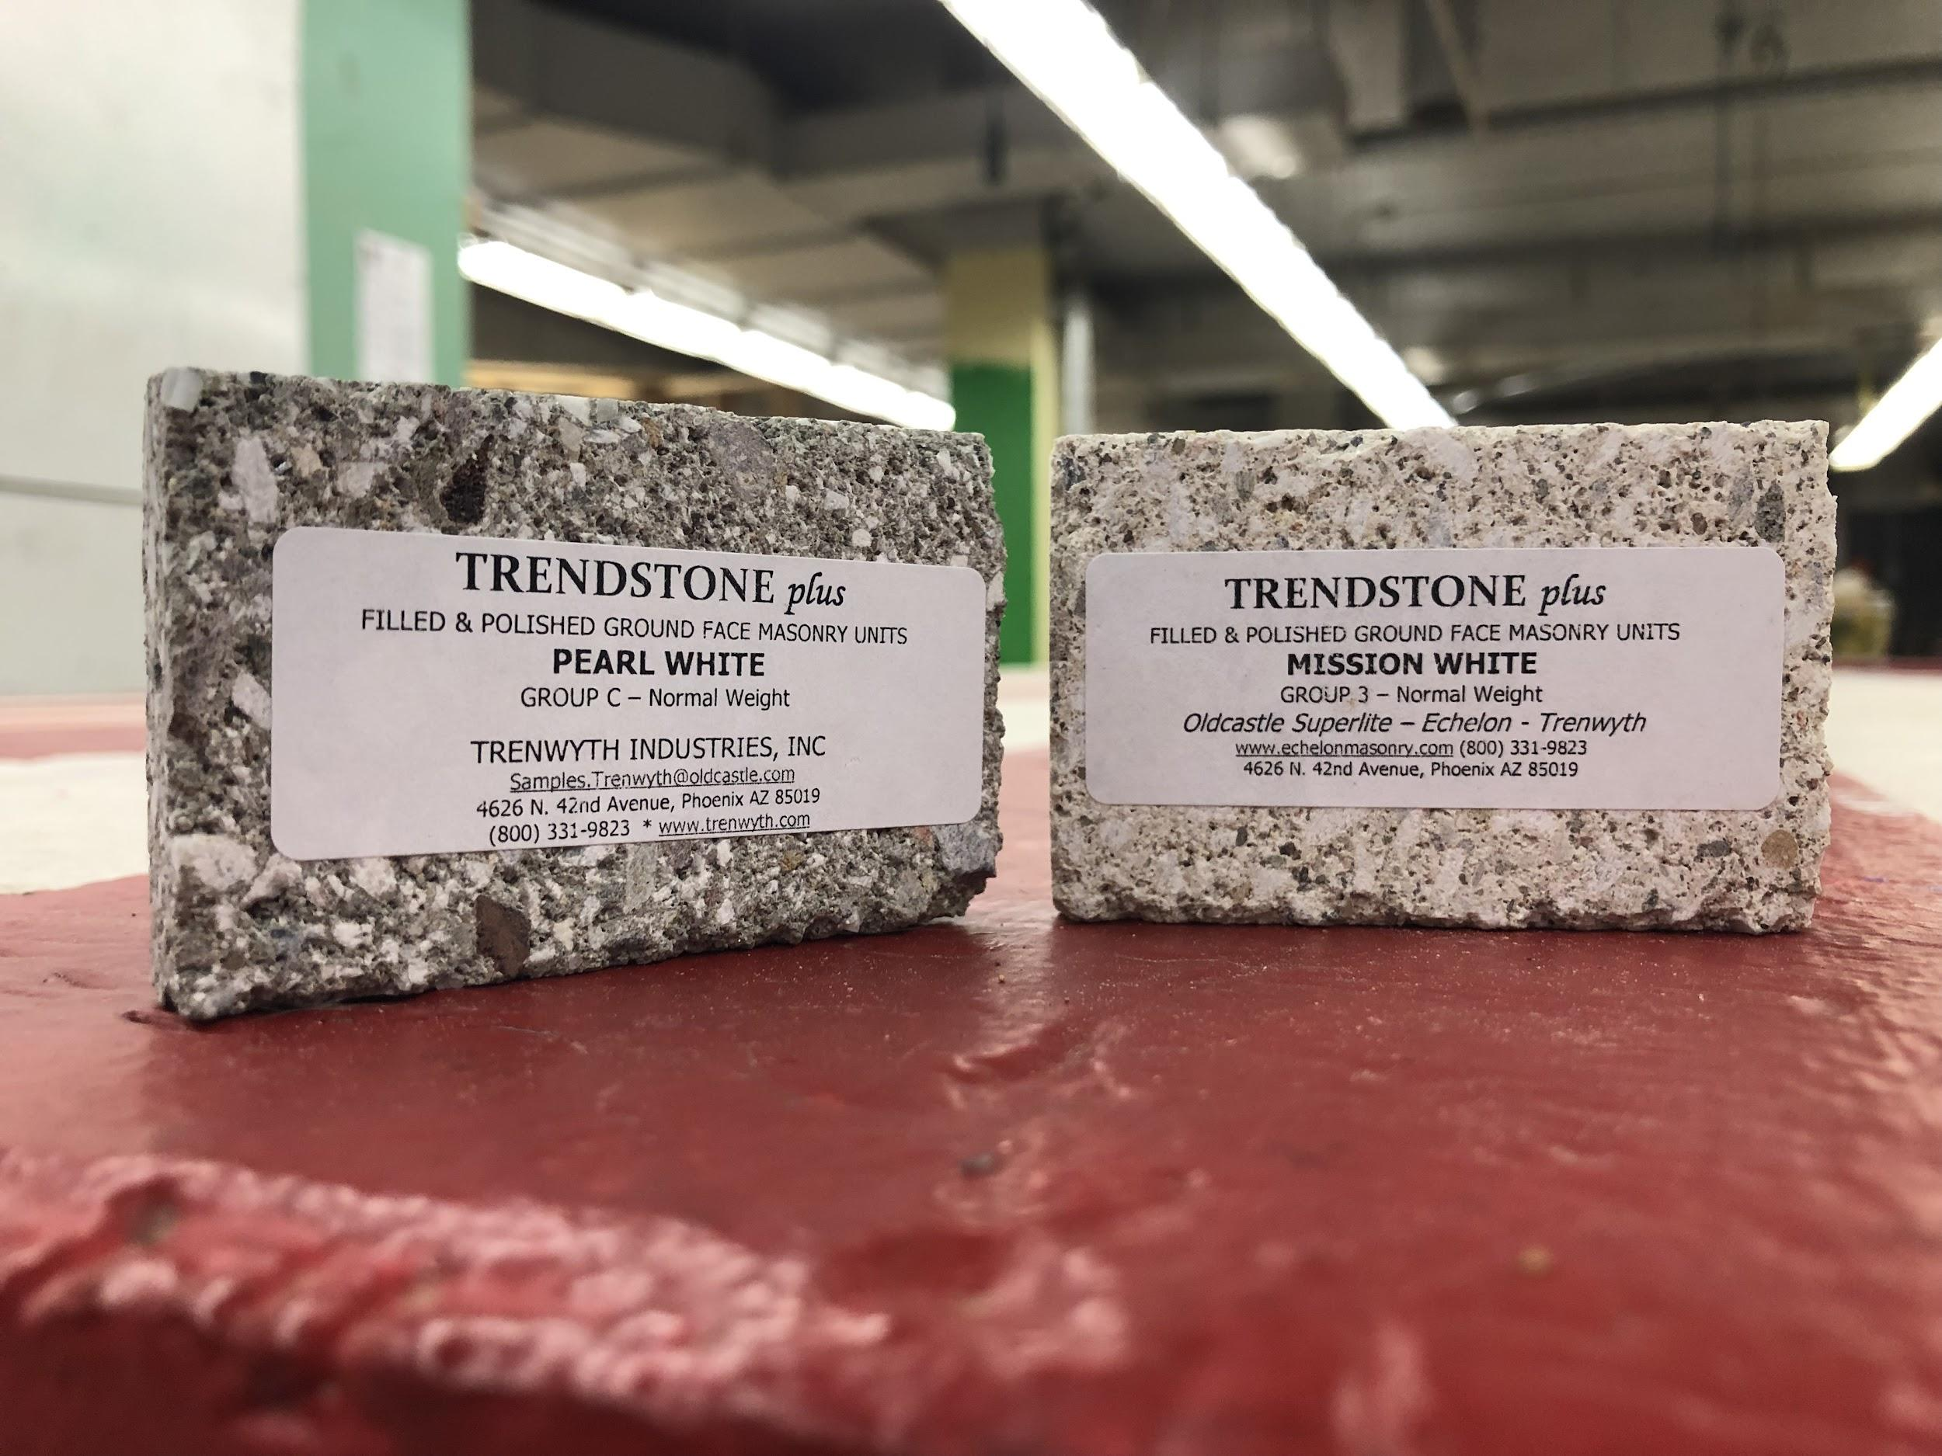
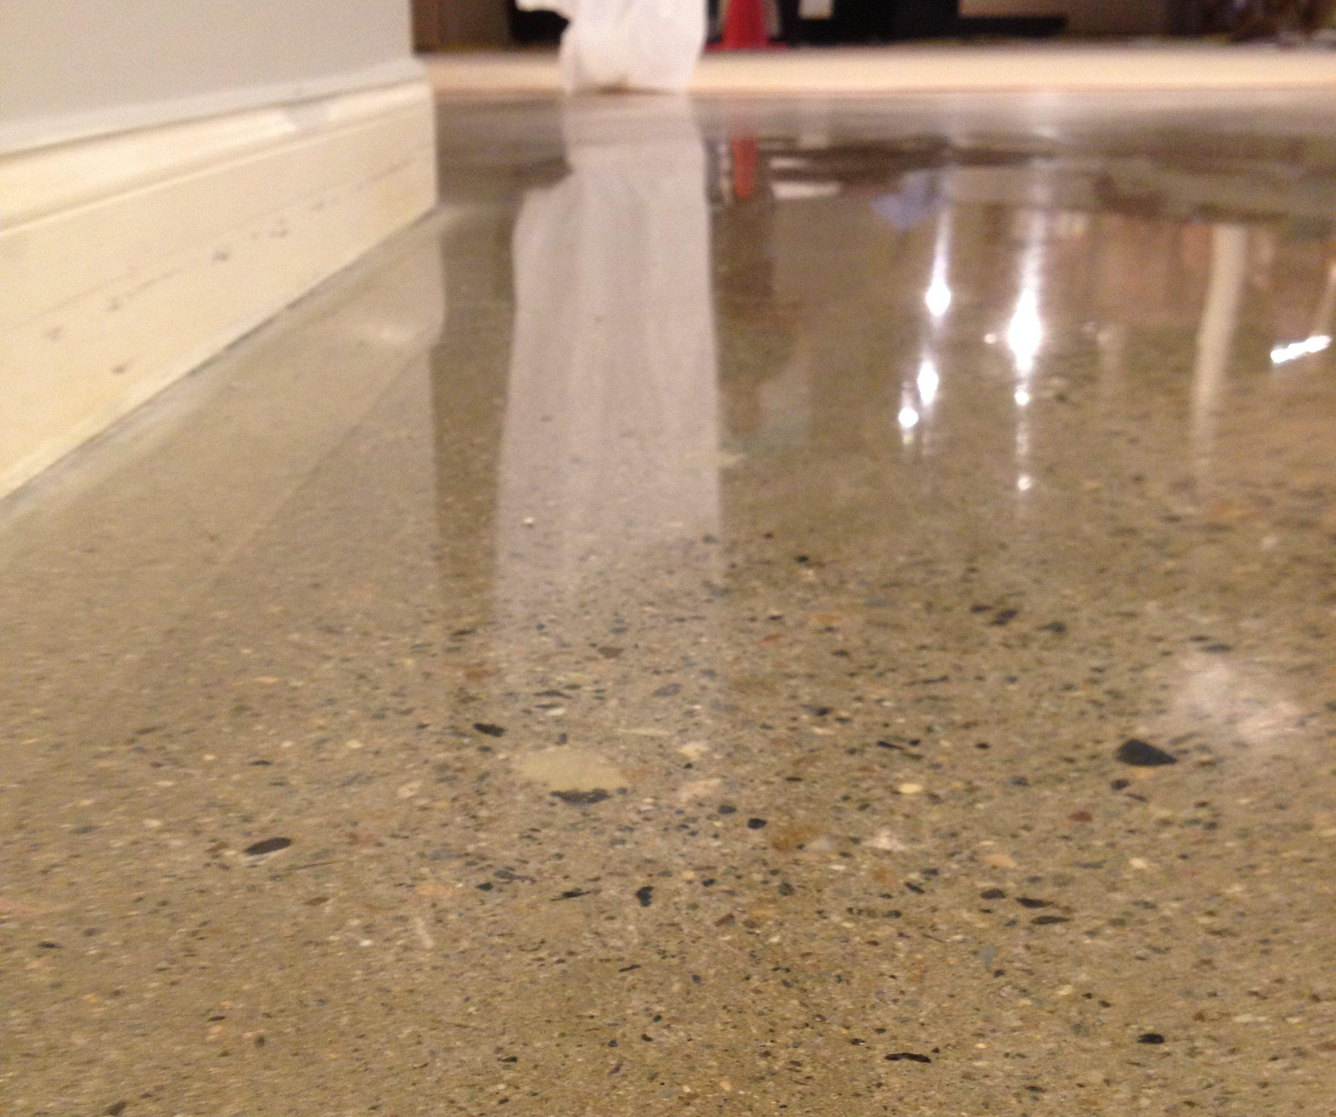
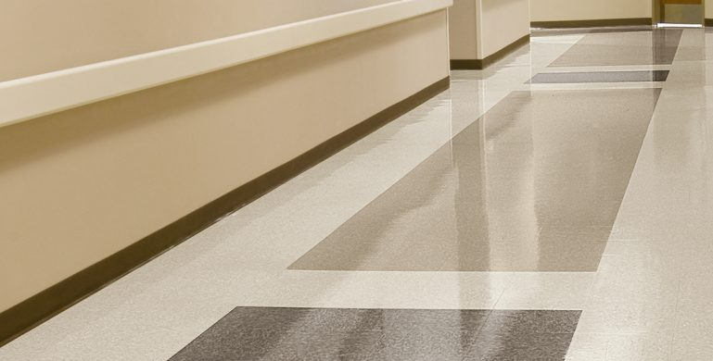
Finishes
Glazing (SNX 62/27) 62% Transmittance .27 Solar Heat Gain Coefficient
Wall (Generally Drywall) Feature Wall- Filled and Polished Ground Face Masonry Pearl White and Mission White
Flooring Exam rooms and common areas- Rubber Flooring
Storage rooms- Ground Polished Concrete
Notes:
Luis
Transmittance - light that goes through
SHGC - solar heat that it gains and transmits inside a room
Featured Wall → in the lobby for directory and behind reception (for aesthetics)
make into separate slides
VCT- economically feasible and easy to clean
Polished Concrete has a nice finish

Slide 22
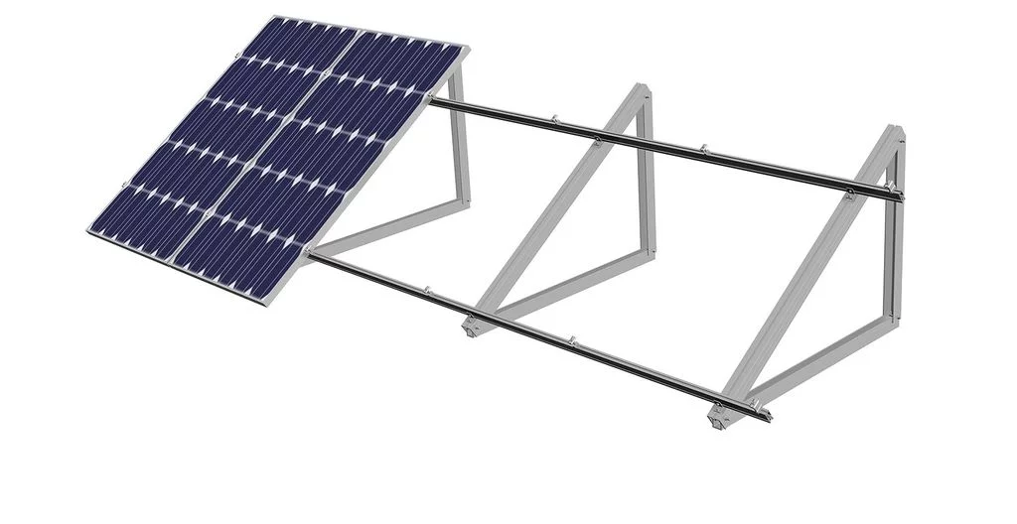
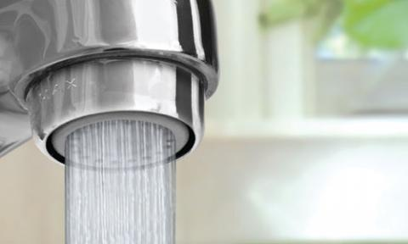
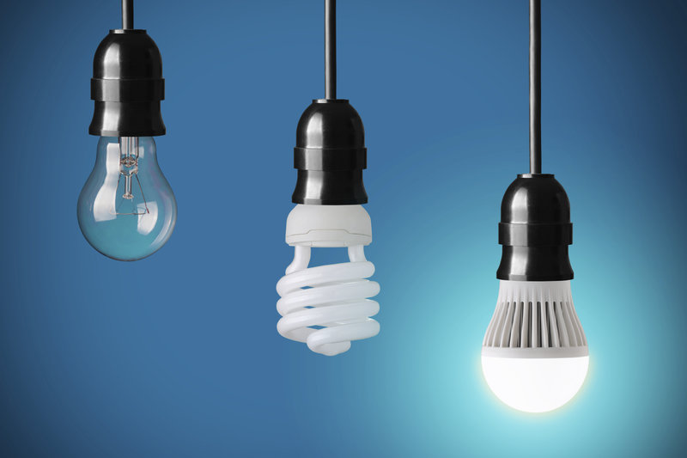
MEP
All mechanical, electrical, and plumbing components will be replaced as required for new construction.
Notes:
angel

Slide 23
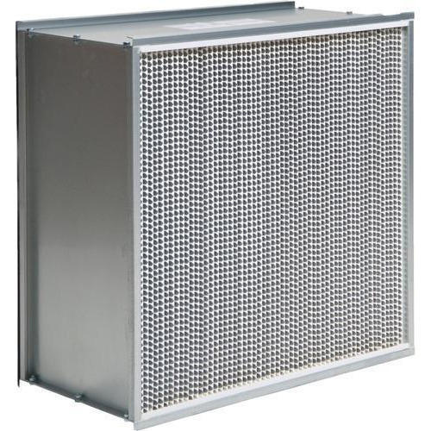

Mechanical cont.
Replace air handling units
Reduce cost of filtration
Maximize effectiveness
Less energy
HEPA filters
Cooling Tower is too expensive to replace, routine maintenance
Notes:
angel
The building is old and it uses a lot of electricity, the cost of replacing the mechanical components will pay off in the long run by energy efficiency, safety, and effectiveness. New air handling unit

Slide 24



Non-Potable Water
Non-potable has many uses to conserve water through reuse including:
Toilet flushes
Irrigation
Cooling towers
Notes:
ailyn
Non-Potable water toilets and irrigation systems can conserve thousands of gallons of water. 4% of water in Phoenix is nonpotable water now and we want to use it if it is a

Slide 25



Dynamic Glazing
Perfect for any time of day
Dynamic glazing will be applied in order to electronically adjust the light transmittance to:
4%
20%
40%
60%
As a result, it minimizes the carbon footprint of the HVAC system, while only using as much electricity as a light bulb.
Notes:
michael

Slide 26


Lighting
Focusing on natural light, the building will consist of a combination of tunable white lights and LED lights.
75% of the lights will be photovoltaic, using power harvested by the solar panels on the parking lot awning.
Notes:
Daniela

Slide 27


Technology
Interactive wall in waiting room
health related displays
directory smart maps
Self check-in kiosk
with estimated waiting time
Notes:
Daniela
Work on this

Slide 28

Budget
We’re under budget!
Total budget $21 million
Interior expenses
$14,400,000
Exterior expenses
$590,000
Total
$15,000,000
Contingency: 4%-
$ 750,000
Remaining $5,304,000
Notes:
ailyn

Slide 29

Schedule
Start date:
February 15, 2019
Demolition:
March 15, 2019
Finishes:
June 6, 2019
End Date:
July 22, 2019
Notes:
Angel

Slide 30

Recap slide
Sustainability inside and out
Photovoltaic panels
Non-potable water
Efficient mechanical, plumbing, finishes
Water efficient plumbing
New air handling unit
LED lighting
Natural lights
Skylights
Glazed windows
Technology
Interactive walls
Check in kiosks
Notes:
Luis

Slide 31
Merci beaucoup
Notes:
Luis

